Slide 1
Web Design and Programming
Week 2
25 April 2024
Instructor: Dr. Peeraya Sripian

Slide 2
Course schedule
Week | Date | Topic
1 | 4/18 | Intro to WWW, Intro to HTML
2 | 4/25 | CSS Fundamental
 | 5/2 | Holiday (GW)
3 | 5/9 | CSS and Bootstrap
4 | 5/16 | Work on midterm project
5 | 5/23 | COIL presentation submission of progress of midterm project
6 | 5/30 | Midterm project presentation week
7 | 6/6 | PHP fundamentals + Installation XAMPP
8 | 6/13 | PHP fundamentals 2
9 | 6/20 | mySQL fundamentals
10 | 6/27 | Assessing MySQL using PHP, MVC pattern + Intro of Final project
11 | 7/4 | Cookies, sessions, and authentication + Proposal of final project
12 | 7/11 | Javascript and PHP validation
13 | 7/18 | Final project development
14 | 7/25 | Final project presentation
COIL 22 MAY 18:00-19:30 (counted as 1 class, replacing 23 May)
Notes:
Collaboration presentation
UPM – already talk about connection (MySQL + PHP)
Student can show project (HTML, CSS) and also the connection -> idea for SIT student to do final project (UPM student emphasize on CRUD, technological points – knowledge up to our 10th week)
SIT student – present HTML , CSS, bootstrap, comment on Design of UPM projects
In the future we can add more
Class time at UPM
Group1: Monday 2-4pm, Tuesday 2-5pm (no experience group)
Group2: Thursday 2-5pm, Friday 9-11am
SIT
Thursday 9-12:30 JST (-> 8-11:30)
Think about arrange extra class for COIL (maybe after 6pm or during lunch break in Japan)
Next mtg – FRI 14 Apr 11:30 (Malaysia time)

Slide 3
This week’s learning objective
Basic HTML for structuring the webpage
Mark up text
Links
Images
Tables

Slide 4
Today’s outline
Review from last time
HTML for structure
Marking up text
Adding links
Adding images
Table markups
Midterm project explanation
In class activity
Break 10 mins
Break 10 mins

Slide 5
Internet vs. WWW in summary
Review | From last time
Internet is a worldwide set of computer networks for personal, commercial, academic, and government use.
WWW is a subset of the internet containing a set of web pages and sites.
IP is used for addressing of internet communication, each computer on the internet has IP address.
Web emails file transfer are layered on top of TCP
URL map to IP address through a service called DNS
HTTP allows a browser to request a web document
Web programming involves many languages: HTML, CSS, PHP, Javascript, XML, and SQL
Review | From last time

Slide 6




How static web pages are processed
Review | From last time
HTTP request
HTTP response (with HTML)
Client
(Web browser)
Web server
HTML file
A static webpage is an HTML document stored on a web server and does not change
Usually with filenames .htm .html
When user request a static webpage, the browser send HTTP request include the filename
Web server retrieve HTML from webpage and send it back to browser as part of HTTP response
Browser then renders the HTML into a webpage and display
Review | From last time

Slide 7


How dynamic web pages are processed
Review | From last time
HTTP request
HTTP response (with HTML)
Client
(Web browser)
Web server
Application Server
Database Server
A dynamic webpage is a webpage that is generated by a server-side program or script.
A web server would looks up the extension of the requested file to find out which application server should process the request
Application server runs the specified script. Often uses the data get from web browser to get the appropriate data from a database server.
When application server finishes processing the data, it generates the HTML for a web page and returns to web server, then return to web browser as part of HTTP response.
Review | From last time

Slide 8
Structure of a minimal HTML page
Review | From last time
<!DOCTYPE html>
<html>
<head>
information about the page
</head>
<body>
page contents
</body>
</html>
the header describes the page
the body contains the page's contents
an HTML page is saved into a file ending with extension .html
DOCTYPE tag tells browser to interpret our page's code as HTML5, the
Header
Body
Review | From last time

Slide 9
About HTML codes
You can find all necessary HTML codes and explanation from w3schools.com
This lecture will provide insight to the necessary HTML structure, often used tags only.
Please make a good use of w3schools and ChatGPT (yes, of course) when you want to create the website

Slide 10
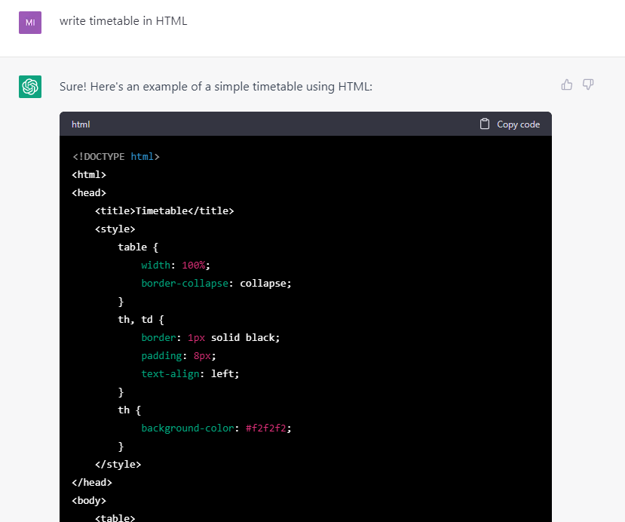
ChatGPT and website
ChatGPT can be a valuable resource
However, the most important is “how you get to the result”, not the result itself
So the process of learning is what you should achieve through this class
You can use it to help check your code for errors, to explain the difficult code for your better understanding
Failure to explain your own source code will result in receiving zero for the assignment

Slide 11

HTML for structure
Marking up text

Slide 12
Markup Tips
It is important to mark up content semantically, in a way that accurately describes the content’s meaning or function.
This ensures your content is accessible in the widest range of viewing environments:
Desktop and mobile browsers
Assistive reading devices
Search engine indexers

Slide 13

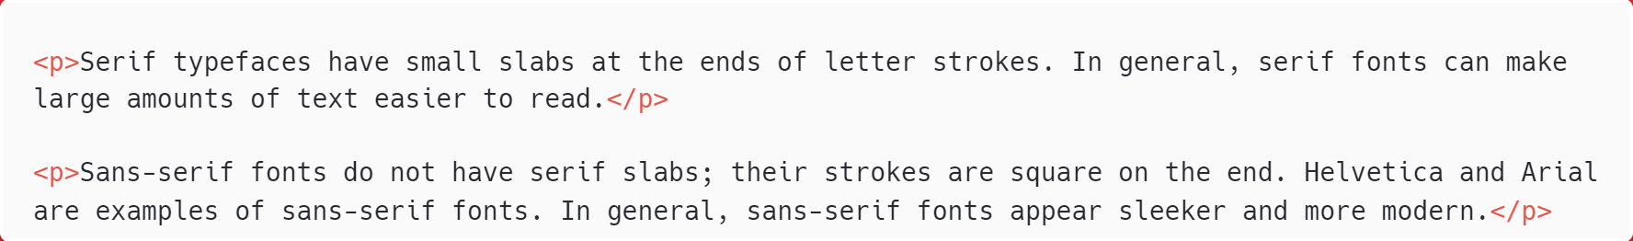
Paragraphs
Use often
The easy way to try your code: https://jsfiddle.net/
<p> </p>
Paragraphs are the most rudimentary elements in a text document.

Slide 14
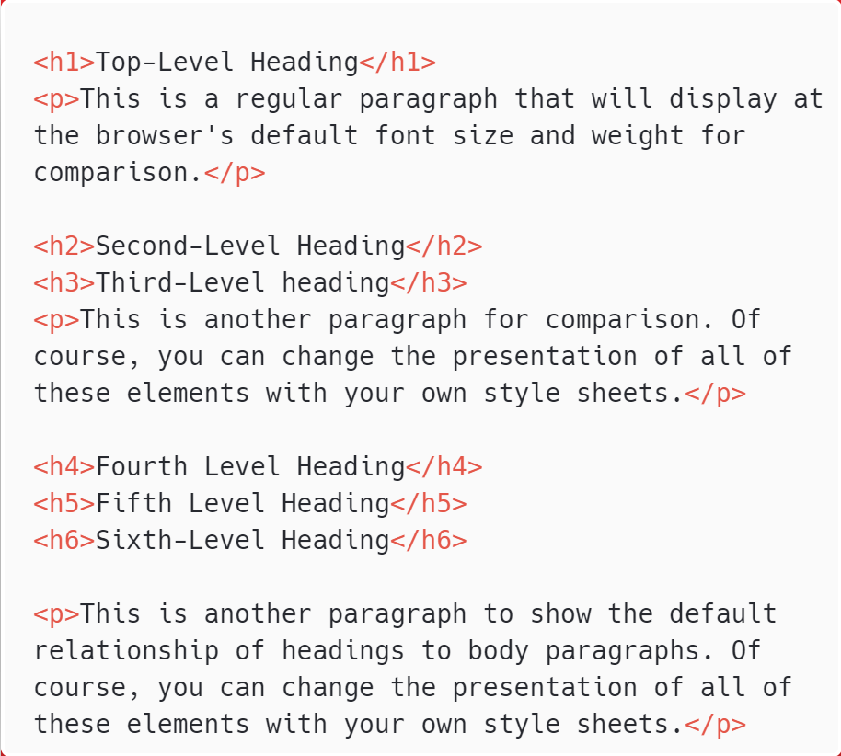
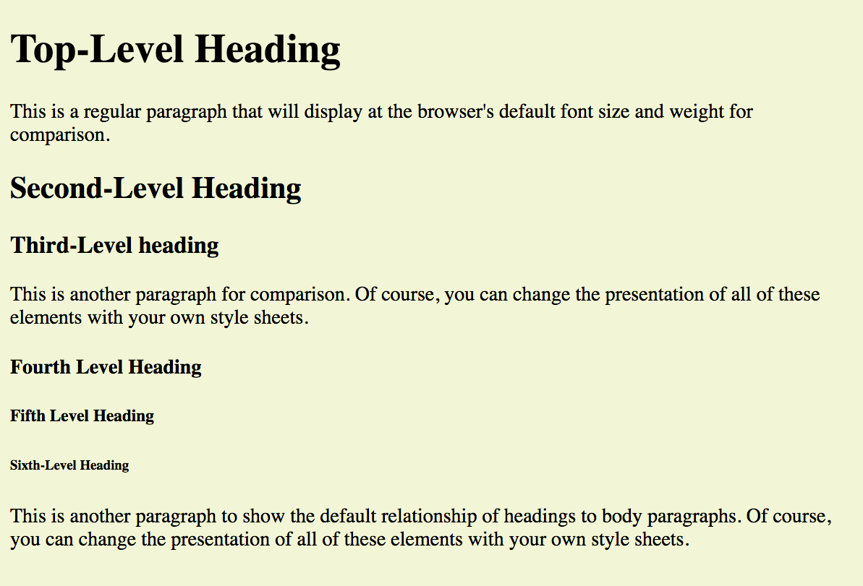
Headings
Use often
<h#> </h#>
There are six levels of headings (h1 to h6).
Output in the browser
h1
h2
h3
h4
h5
h6

Slide 15
Headings (cont’d)
Used to create the document outline.
Help with accessibility and search engine indexing.
Recommended to start with h1 and add subsequent levels in logical order.
Don’t choose headings based on how they look; use a style sheet to change them.

Slide 16
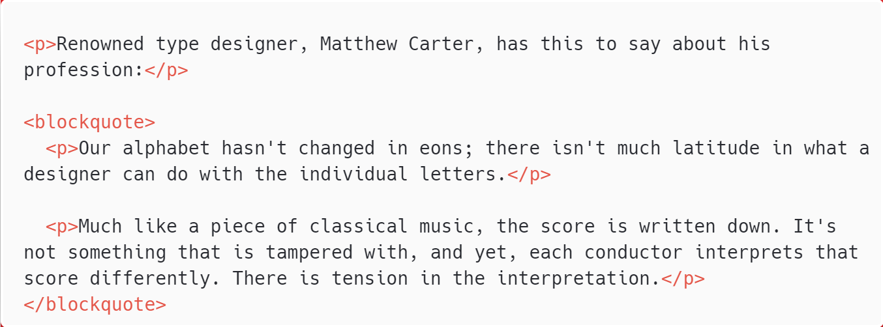
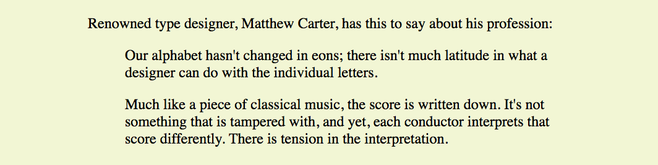
Long Quotations (blockquotes)
Skip explanation
<blockquote> </blockquote>
Output in the browser

Slide 17
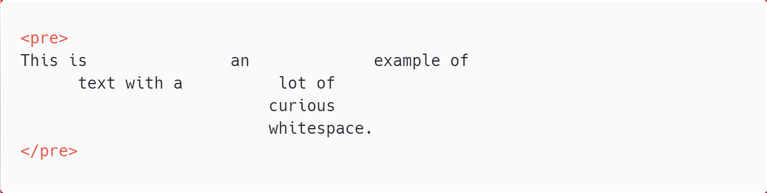
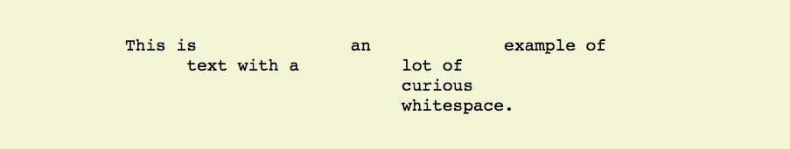
Preformatted Text
Skip explanation
<pre> </pre>
Preformatted text preserves white space when it is important for conveying meaning. By default, pre text displays in a constant-width font, such as Courier.
Output in the browser

Slide 18

Line Breaks
Use often
<br>
The empty br element inserts a line break.
Output in the browser

Slide 19
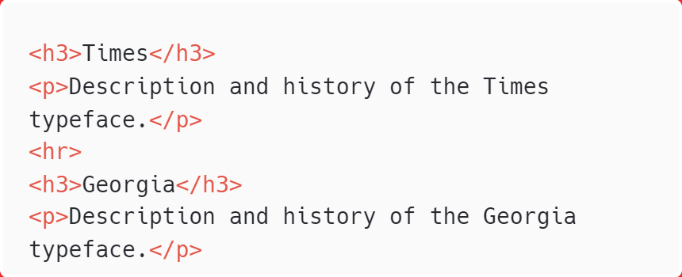
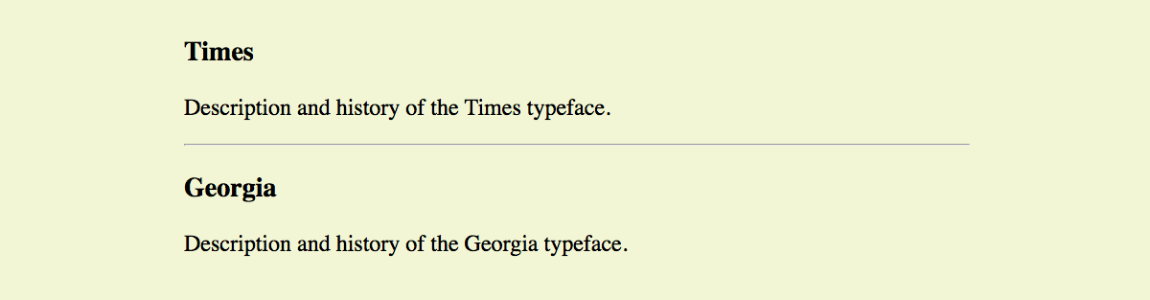
Thematic Breaks (Horizontal Rules)
<hr>
Indicates one topic has completed and another one is beginning. Browsers display a horizontal rule (line) in its place:
Output in the browser

Slide 20
Lists
There are three types of lists in HTML:
Unordered lists
Ordered lists
Description lists

Slide 21
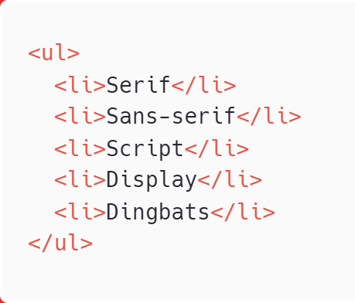
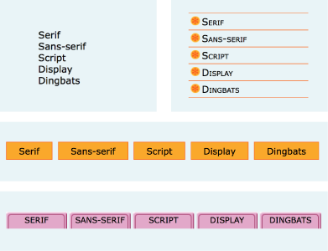
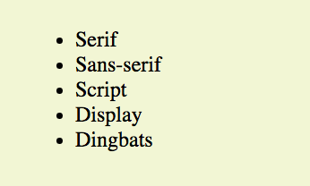
Unordered Lists
Use often
In unordered lists items may appear in any order (examples, names, options, etc.). Most lists fall into this category.
<ul> </ul> Defines the whole list
<li> </li> Defines each list item
You can change the appearance of the list dramatically with style sheet rules.
Output in the browser

Slide 22
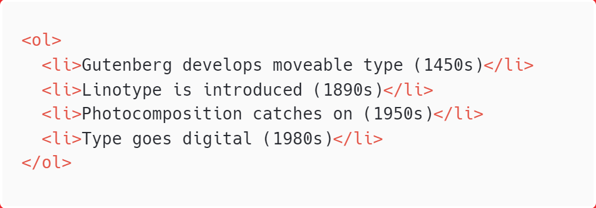
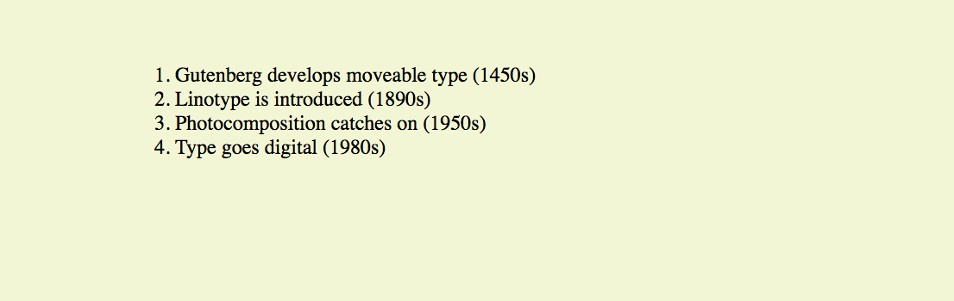
Ordered Lists
Use often
In ordered lists items occur in a particular order, such as step-by-step instructions or driving directions.
<ol> </ol> Defines the whole list
<li> </li> Defines each list item
Output in the browser

Slide 23
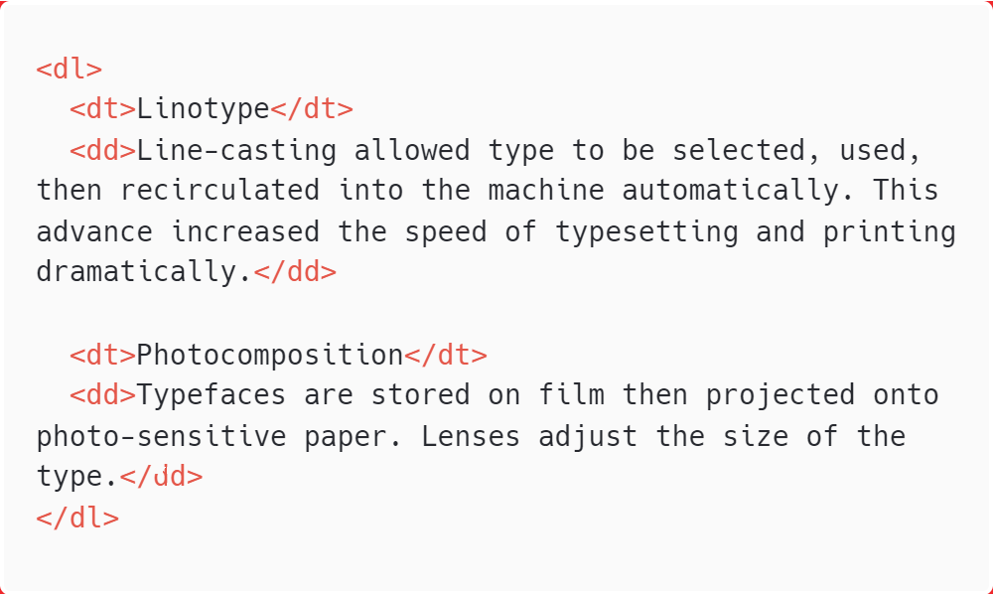
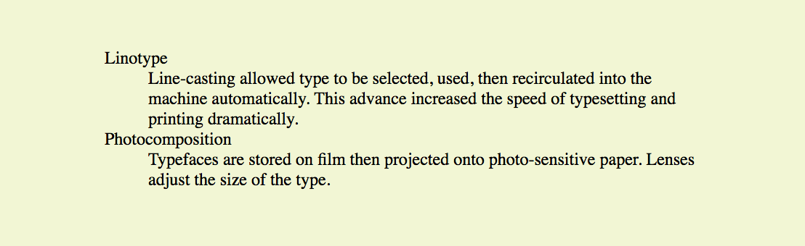
Description Lists
Skip explanation
Description lists are used for any type of name/value pairs, such as terms/definitions, questions/answers, etc.
<dl> </dl> Defines the whole list
<dt> </dt> Defines a name, such as a term
<dd> </dd> Defines a value, such as a definition
Output in the browser

Slide 24
Page Organizing Elements
HTML5 introduced elements that give meaning to the typical sections of a web page:
main
header
footer
section
article
aside
nav

Slide 25
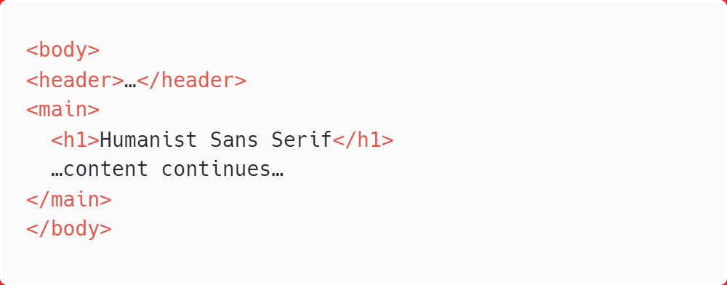
Main Content
Use often
<main> </main>
Identifies the primary content of a page or application
Helps users with screen readers get to the main content of the page
Requires JavaScript workaround in Internet Explorer

Slide 26
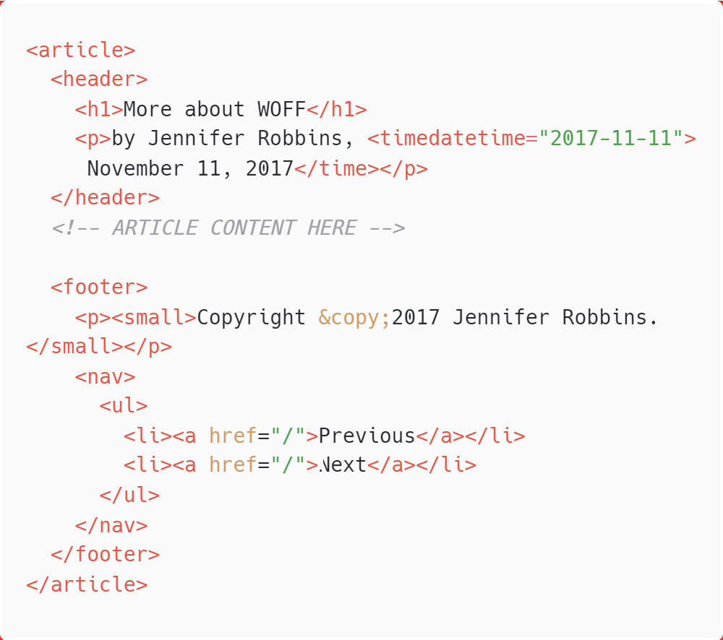
Headers and Footers
Use often
<header> </header>
<footer> </footer>
header identifies the introductory material that comes at the beginning of a page, section, or article (logo, title, navigation, etc.).
footer indicates the type of information that comes at the end of a page, section, or article (author, copyright, etc.)

Slide 27
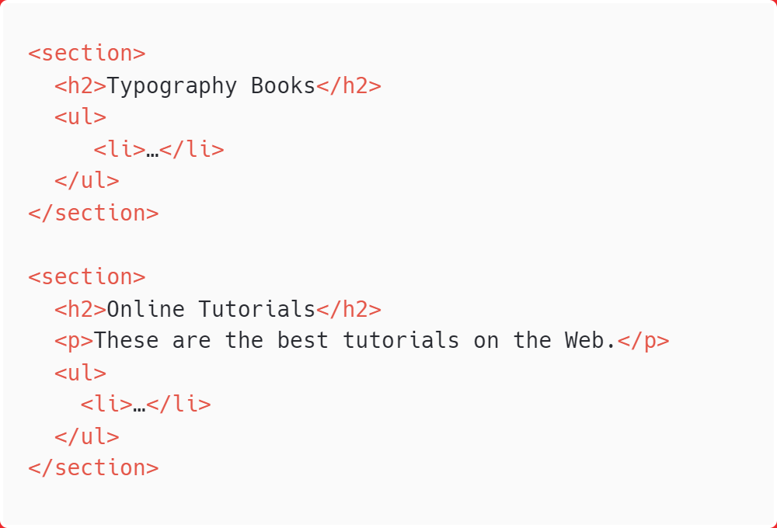
Sections
Use often
<section> </section>
section identifies thematic section of a page or an article. It can be used to divide up a whole page or a single article:

Slide 28
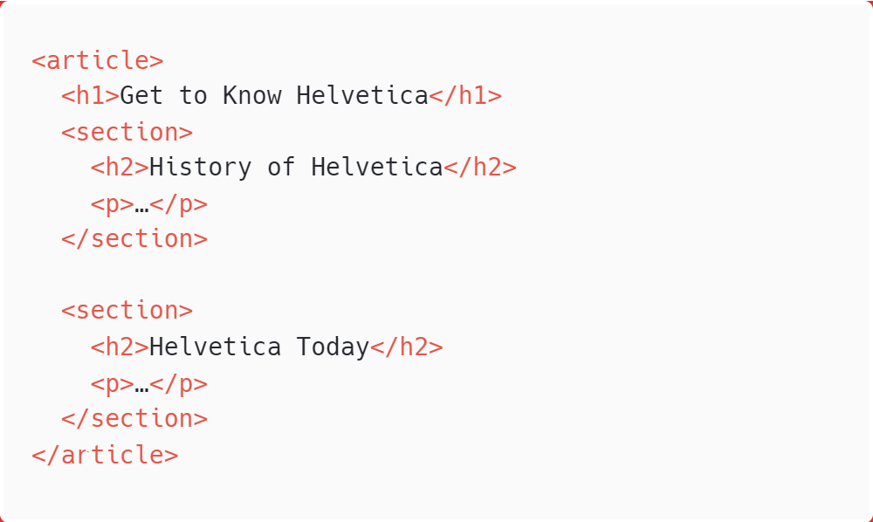
Articles
Use often
<article> </article>
article is used for self-contained works that could stand alone or be used in a different context (such as syndication).
Useful for magazine/newspaper articles, blog posts, comments, etc.

Slide 29
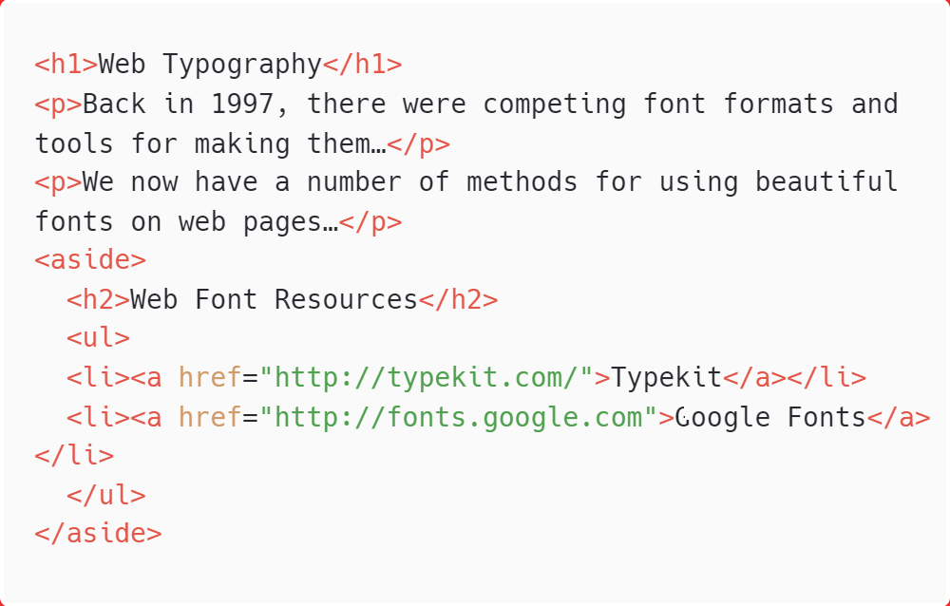
Aside (Sidebar)
Use often
<aside> </aside>
aside identifies content that is separate from but tangentially related to the surrounding content (think of it as a sidebar).

Slide 30
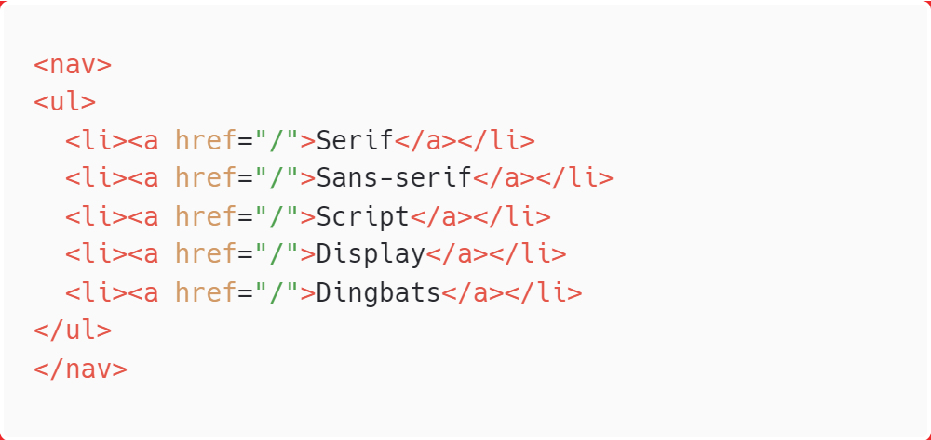
Navigation
Use often
<nav> </nav>
nav identifies the primary navigation for a site or lengthy section or article. It provides more semantic meaning than a simple unordered list.

Slide 31
Inline Elements
Called text-level semantic elements in the spec.
Describe the types of elements that appear in the flow of text.
a
em
strong
q
abbr
cite
dfn
code
var
samp
kbd
sub/sup
mark
time
data
ins/del
b
i
s
u
small
bdi/bdo
data
span

Slide 32
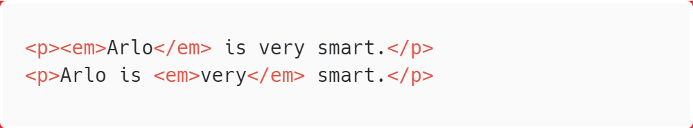
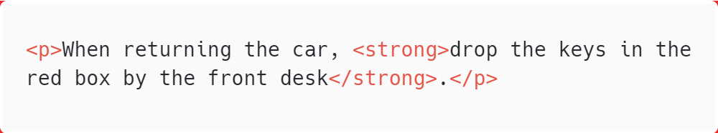
Inline Elements
Emphasis
Use often
<em> </em>
Text that should be emphasized. Usually displayed in italics.
<strong> </strong>
Text that is important, serious, or urgent. Usually displayed in bold.
TIP: Use these elements semantically, not to achieve font styles. Think of how it would be read with a screen reader.

Slide 33
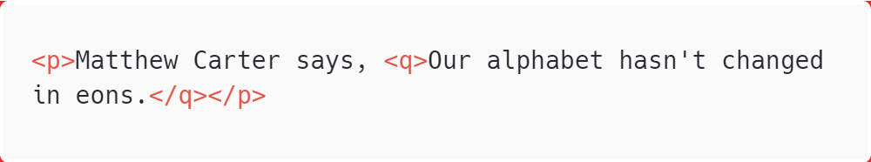

Inline Elements
Short Quotations
Use often
<q> </q>
For quoted phrases in the flow of text. Browsers add appropriate quotation marks automatically.
Output in the browser

Slide 34
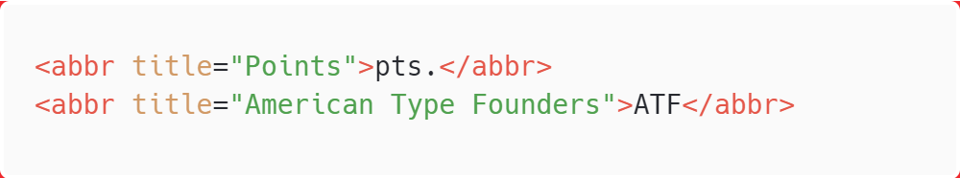
Inline Elements
Abbreviations and Acronyms
Skip explanation
<abbr> </abbr>
The title attribute provides the long version of a shortened term, which is helpful for search engines and assistive devices.

Slide 35
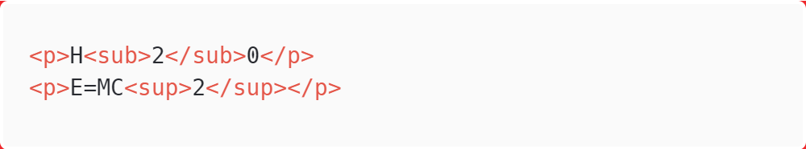

Inline Elements
Superscript and Subscript
<sup> </sup>
<sub> </sub>
Causes the selected text to display in a smaller size and slightly above (sup) or below (sub) the baseline.
Output in the browser

Slide 36
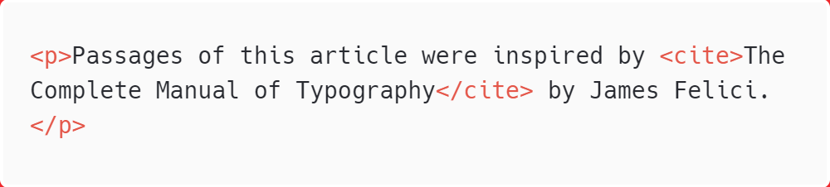
Inline Elements
Citations
Skip explanation
<cite> </cite>
Identifies a reference to another document.
Output in the browser

Slide 37
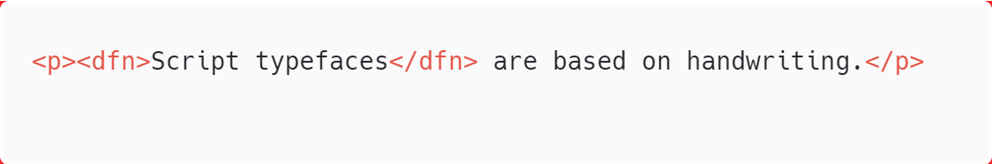
Inline Elements
Defining Terms
Skip explanation
<dfn> </dfn>
Identifies the first and defining instance of a word in a document. There is no default rendering, so you need to format them using style sheets.

Slide 38
Inline Elements
Code-Related Elements
<code> </code> Code in the flow of text
<var> </var> Variables
<samp> </samp> Program sample
<kbd> </kbd> User-entered keyboard strokes

Slide 39
Inline Elements
New Semantic Definitions for Old Presentational Inline Elements
<b> </b> Phrases that need to stand out without added emphasis or importance (bold)
<i> </i> Phrases in a different voice or mood than the surrounding text (italic)
<s> </s> Text that is incorrect (strike-through)
<u> </u> Underlined text, when underlining has semantic purpose
<small> </small> Addendum or side note (smaller text size)

Slide 40
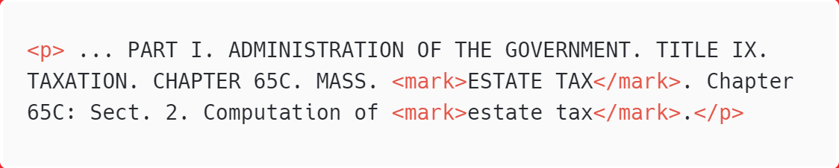
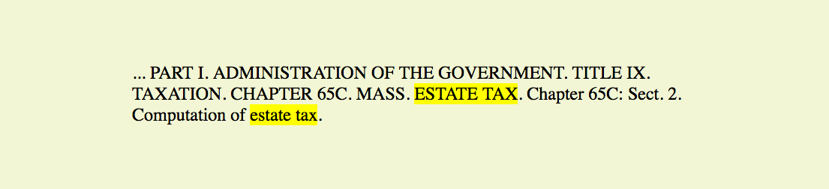
Inline Elements
Highlighted Text
Skip explanation
<mark> </mark>
For phrases that may be particularly relevant to the reader (for example, when displaying search results):
Output in the browser

Slide 41
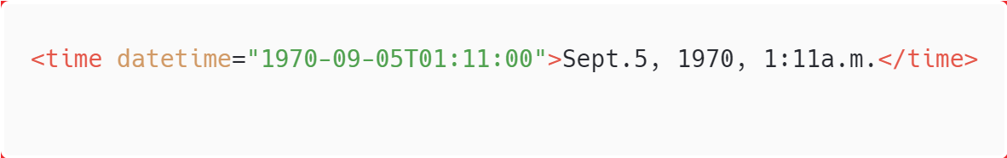
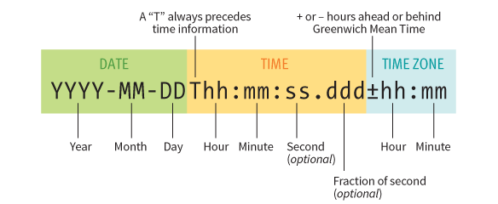
Inline Elements
Dates and Times
Skip explanation
<time> </time>
Provides machine-readable equivalents for dates and times. The datetime attribute specifies the date/time information in a standardized time format:

Slide 42
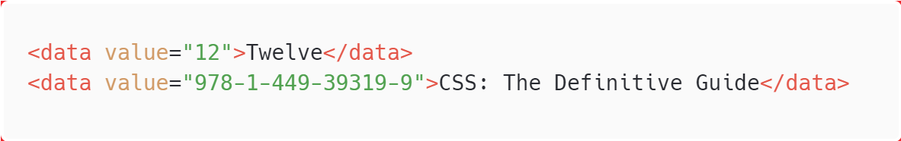
Inline Elements
Machine-Readable Information
Skip explanation
<data> </data>
Helps computers make sense of content.
The value attribute provides the machine-readable information.

Slide 43
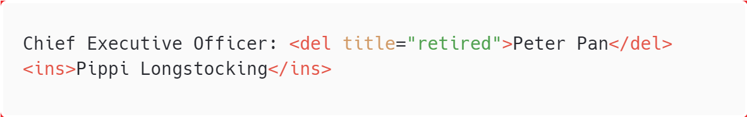
Inline Elements
Inserted and Deleted Content
<ins> </ins>
<del> </del>
Markup for edits indicating parts of a document that have been inserted or deleted:

Slide 44
Generic Elements
Use often
<div> </div>
Indicates division of content (generally block-level)
<span> </span>
Indicates a word or phrase
Generic elements are given semantic meaning with the id and class attributes.
They are useful for creating “hooks” for scripts and style rules.

Slide 45
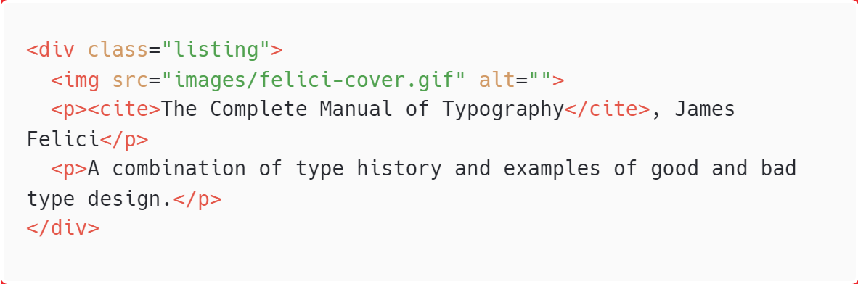
Div Example
Use the div element to create a logical grouping of content or elements on the page.
It indicates that they belong together in some sort of conceptual unit or should be treated as a unit by CSS or JavaScript.

Slide 46
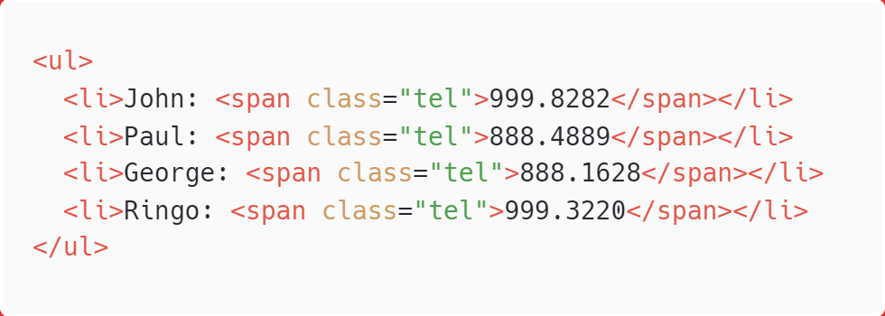
Span Example
Use the span element for text and other inline elements for which no existing inline element currently exists.
In this example, a span is used to add semantic meaning to telephone numbers:

Slide 47
id and class Attributes
Use often
id
Assigns a unique identifier to the element.
class
Classifies elements into a conceptual group.
Use the id attribute to identify. Use the class attribute to classify.
NOTE: id and class can be used with all HTML elements.

Slide 48
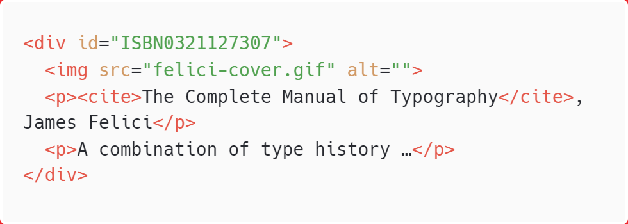
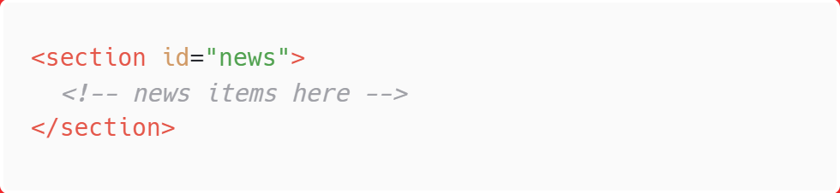
The id Attribute
The value of an id attribute must be used only once in a document.
Here it identifies a listing for a particular book by its ISBN:
Here it identifies a particular section of a document:

Slide 49
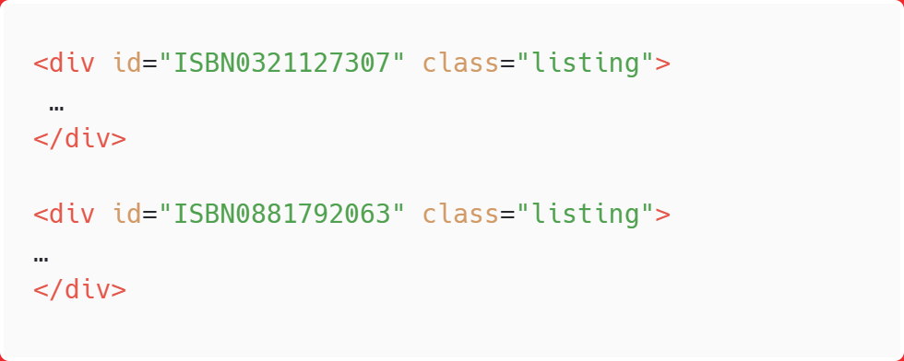
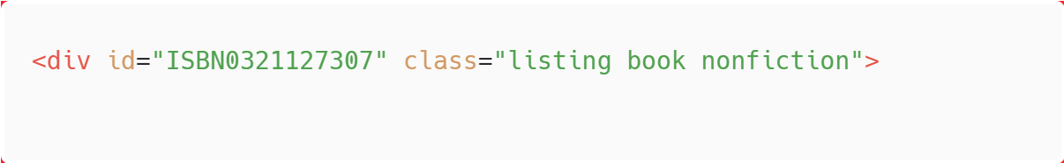
The class Attribute
A class value may be used by multiple elements to put them in conceptual groups for scripting or styling.
Here several book listings are classified as a “listing”:
An element may belong to more than one class. Separate class values with character spaces:

Slide 50
Improving Accessibility with ARIA (WAI-ARIA)
www.w3.org/TR/html-aria
ARIA (Accessible Rich Internet Applications) is a standardized set of attributes for making pages easier to navigate and use with assistive devices.
ARIA defines roles, states, and properties that developers can add to markup and scripts to provide richer information.
Considering that your web users may be listening to the content on the page read by the screen reader, or use other non-mouse devices to navigate your page
HTML elements such as title, headings, images are semantically meaningful in itself
However, generic elements (div, span) needs some assitance
Notes:
As web designers, we must always consider the experience of users with assistive
technologies for navigating pages and interacting with web applications.
Your users may be listening to the content on the page read aloud by a screen
reader and using keyboards, joysticks, voice commands, or other non-mouse
input devices to navigate through the page.
Many HTML elements are plainly understood when you look at (or read)
only the HTML source. Elements like the title, headings, lists, images, and
tables have implicit meanings in the context of a page, but generic elements
like div and span lack the semantics necessary to be interpreted by an assistive
device. In rich web applications, especially those that rely heavily on
JavaScript and AJAX (see Note), the markup alone does not provide enough
clues as to how elements are being used or whether a form control is currently
selected, required, or in some other state.

Slide 51
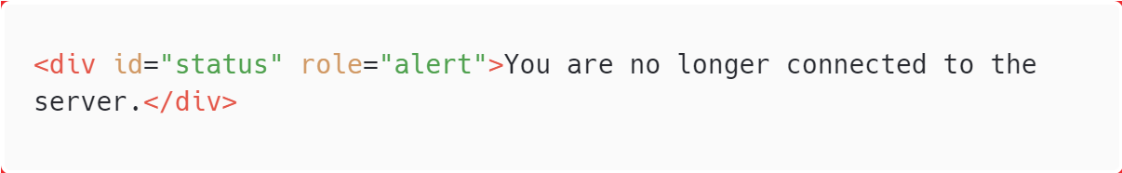
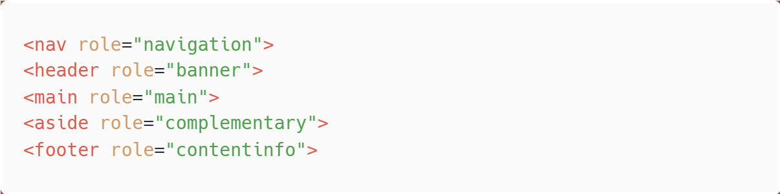
ARIA Roles
Roles describe or clarify an element’s function in the document.
Examples: alert, button, dialog, slider, and menubar

Slide 52
ARIA States and Properties
ARIA defines a long list of states and properties that apply to interactive elements and dynamic content.
Properties values are likely to be stable (example: aria-labelledby).
States have values that are likely to change as the user interacts with the content (example: aria-selected).

Slide 53
Escaping Characters
Escaping a character means representing it by its named or numeric character entity in the source.
Some characters must be escaped because they will be mistaken for code (example: the < character would be parsed as the start of an HTML tag).
Some characters are invisible or just easier to escape than find on the keyboard.

Slide 54
Character Entity References
Character entities always begin with & and end with ;.
Named entities
Use a predefined name for the character (example: &lt; for the less-than symbol <)
Numeric entities
Use an assigned numeric value that corresponds to its position in a coded character set, such as UTF-8 (example: &#060; for the less-than symbol <).
A complete list of HTML named entities and their Unicode code-points is at www.w3.org/TR/html5/syntax.html#named-character-references.

Slide 55
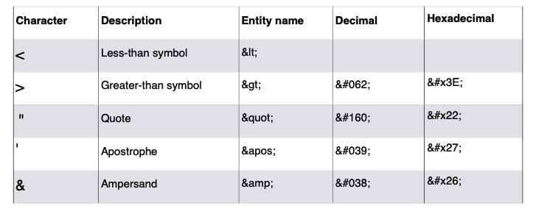
Escaping HTML Syntax Characters
Always escape <, >, and & characters in content. Escape " and ' when they are in attribute values.

Slide 56

HTML for structure
Break 5 min
Adding links

Slide 57
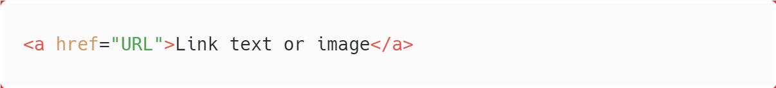
Adding Links
Use often
<a> </a>
The href attribute provides the location (URL) of the resource.
You can link to any resource:
HTML documents
Images
Movies
PDFs
More!

Slide 58
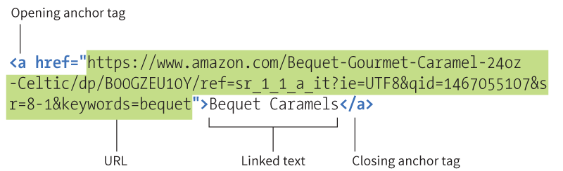
href Attributes
Absolute URLs begin with the protocol (ex: http://).
Relative URLs provide the path to a file on the same server as the document containing the link (ex: /directory/document.html).
Long URLs can make the markup look complicated, but the structure is the same:

Slide 59
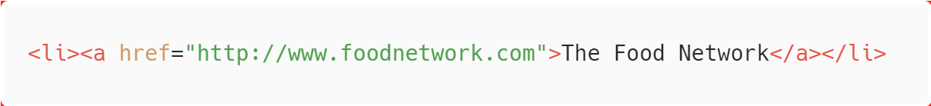
External Links
External links go to pages that are not on your server.
An absolute URL is required, including http://

Slide 60
Linking on Your Own Site
When no protocol is provided, the browser looks on the current server for the resource.
A relative pathname describes how to get to the resource starting from the current document.
Pathnames follow UNIX syntax conventions.

Slide 61
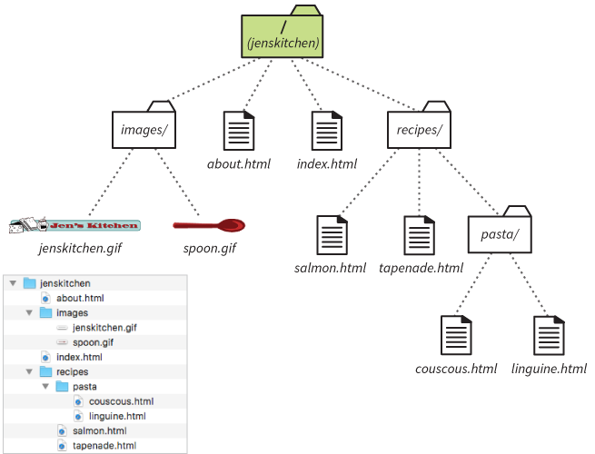
Example Server Directory Structure
In this section, we will use this site structure
The root directory is called jenskitchen.
How it looks in the MacOS Finder

Slide 62
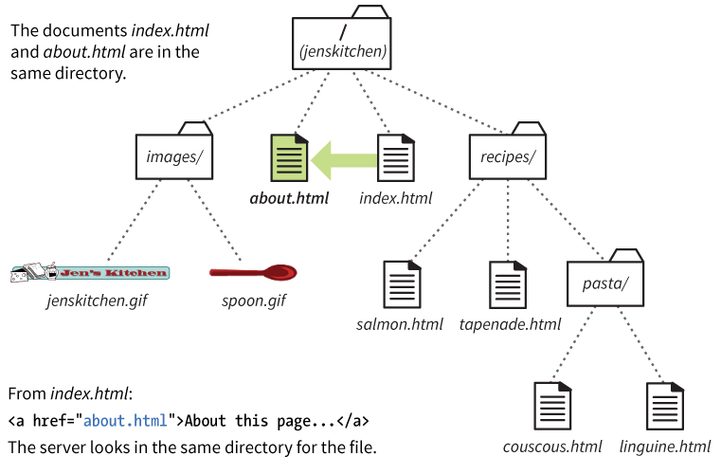
Linking in the Same Directory
When the linked document is in the same directory as the current document, just provide its filename:
href=“about.html”

Slide 63

Linking into a Lower Directory
If the linked file is in a directory, include the directory name in the path.
href=“recipes/salmon.html”

Slide 64

Linking into Two Directories
Include each subdirectory name in the path to the linked document:
href=“recipes/pasta/couscous.html”

Slide 65

Linking to a Higher Directory
To back up a level, the ../ stands in for the name of the higher directory:
href=“../index.html”

Slide 66

Linking Up Two Directory Levels
Include a ../ for each level you need to back up to:
href=“../../index.html”

Slide 67

Site Root Relative Paths
Starting the path with a slash / means the pathname starts at the root directory. You don’t need to write the name of the directory.
href=“/recipes/salmon.html”
NOTE: Site root relative URLs are more flexible because they work from any document on the site.
DOWNSIDE: They won’t work on your own computer because the / will be relative to your hard drive. You’ll need to test it on the actual web server.

Slide 68

Image src Pathnames
Relative pathnames are also commonly used to point to image files with the src attribute:

Slide 69

Linking Within a Page (Fragments)
Linking to a specific point on a web page is called linking to a document fragment.
This is useful for providing links down to content from the top of a long document.

Slide 70


Linking to a Fragment
For example, to create a link from the letter H in a list at the top of the page to the “H” heading farther down in the document:
Step 1: Identify the target destination.
Use the id attribute to give the target element a unique name:
Step 2: Link to the target (#).
The # symbol before the name indicates that the link goes to a fragment:

Slide 71

Targeting Browser Windows
The target attribute in the a tag tells the browser the name of the window in which you want the linked document to open:
target="_blank"
Always opens a new browser window.
target="name"
Opens a new window with that name and then opens all subsequent targeted links with that name in the same window.
It may also open in an embedded frame (iframe) with that name.

Slide 72

Mail Links
Use the “mailto” protocol to make a linked email address open in a mail program:
NOTE: Most browsers are configured to open the computer’s primary email program, but this may not work for some users. Be sure the email address is included on the page and use the mailto link as progressive enhancement.

Slide 73

HTML for structure
Adding images

Slide 74
Web Image Formats
Image formats appropriate for web pages:
PNG
JPEG
GIF
SVG
WebP (up and coming, not yet widely supported)

Slide 75

Bitmapped vs. Vector Formats
PNG, JPEG, GIF, and WebP are bitmapped formats.
SVG is a vector format.

Slide 76
The img Element
Use often
<img src="" alt="">
Embed images on the page with the empty img element.
The src and alt attributes are required.
img can be used for PNG, JPEG, GIF, and SVG.
NOTE: Special markup is recommended for experimenting with cutting-edge image formats like WebP.

Slide 77


The img Element (cont’d)
The img element tells the browser to make a server request for the image and display it in its place:
Output in the browser

Slide 78
The src attribute
The value is the location (URL) of the image file.
Use the relative pathname conventions to point to the image on the server.
PERFORMANCE TIP: Take advantage of caching (temporary storage). For the same image used repeatedly, using the same pathname reduces the number of calls to the server.

Slide 79

The alt Attribute
Output in the browser
The alt attribute provides alternative text for those who are not able to see it.
It is required for every img element in order for the HTML to be valid.
It is used by screen readers, search engines, and graphical browsers when the image fails to load.

Slide 80
Alternative Text Tips
Alternative text (alt text) should convey the same information and function as the image.
If the image is purely decorative and shouldn’t be read aloud, include the alt attribute with an empty value:
Consider what the alt text would sound like when read aloud by a screen reader. Is it helpful or a hindrance?
When an image is used as a link, the alt text serves as the linked text. Write what you’d want the link to say, don’t just describe the image.
Avoid starting alt text with “An image of” or “Graphic of”.

Slide 81
width and height Attributes
The width and height attributes set the dimensions of the image on the page in number of pixels.
They help the browser maintain space for the image in the layout while the files load.
Don’t use width and height attributes if you are sizing the image with style sheets or if the size changes in a responsive layout.
If the attribute values do not match the dimensions of the image, the image will resize and may be distorted or blurry.

Slide 82
Adding SVG Images
SVG images are unique:
SVG is a vector format, made up of shapes and paths.
Those shapes and paths are described in a text file using the Scalable Vector Graphic markup language.
The elements in an SVG can be styled with CSS and scripted for interactivity.
Because they are vector, SVGs can resize with no loss of quality.

Slide 83


SVG Example
Compare the SVG source to the image. The svg element contains a rectangle (rect element) and a text element:
Output in the browser

Slide 84
Adding SVG to a Page
There are several ways to add an SVG image to a web page:
<img> element
<object> element
<svg> element directly in HTML (inline SVG)

Slide 85

Adding SVG with the img Element
You can add an .svg file to the page with the img element:
PROS:
Easy and familiar
Universally supported
CONS:
Can’t manipulate the SVG with scripts or styles.
The SVG can’t contain any external resources such as images or fonts.

Slide 86

Embedding SVGs with object
The content of the object element is a fallback text or image that displays if the SVG is not supported:
PROS:
SVG can be scripted and use eternal files (images and fonts).
CONS:
You can’t change styles with the same CSS used for the document.
May be buggy in some browsers.

Slide 87
Inline SVGs with the svg Element
You can paste the content of the SVG text file directly into the HTML source. This is called using the SVG inline.
PROS:
Can take full advantage of scripting and styling the SVG because the elements in the SVG are part of the DOM for the document.
CONS:
Code can get extremely long and unwieldy.
Harder to maintain images embedded in the source
Can’t take advantage of caching repeated images
Not universally supported

Slide 88


Example of an Inline SVG
Output in the browser

Slide 89
HTML for structure
Table markup

Slide 90

Tabular Data
HTML table markup is for data arranged into rows and columns.

Slide 91


HTML Table Structure
Tables are made up of cells arranged into rows.
A simple table

Slide 92

HTML Table Structure (cont’d.)
How it looks using markup (table, tr, th, and td):
NOTE: Columns are implied by the number of cells in each row (not created with column elements).

Slide 93


HTML Table Structure (cont'd)
The same table written in code:
Default browser display:
Output in the browser

Slide 94
The table Element
Use often
<table> </table>
Identifies tabular material
Contains some number of row (tr) elements
Optionally, may also have a caption element and row and column group elements

Slide 95
Table Row (tr) Element
Use often
<tr> </tr>
tr stands for “table row.”
The only thing that can go between tr tags is some number of th (header) and td (data cell) elements.
There may be no text content in a row that is not contained within a header or data cell.

Slide 96
Table Cells
Use often
<td> </td>
td stands for “table data.”
Cells can contain any type of web content.
All content in a table must be contained in td tags.

Slide 97
Table Headers
Use often
<th> </th>
th stands for “table header.”
Headers provide information about the cells in the row or column they precede.
They are key tools for making table content accessible. Screen readers may read headers aloud before each data cell, providing context that is missing when you can’t see the table.
Headers are often rendered in a bold font by default.

Slide 98


Table Columns Are Implied
This table would have 2 rows and 3 columns (because there are 3 cells defined in each row):
Output in the browser
*I Add border=1 just to make the table border visible in this example, in fact you should decorate (style) it in CSS

Slide 99




Spanning Cells
Spanning
Stretching a cell to cover several rows or columns
Column span
Stretching a cell to the right over subsequent columns
Row span
Stretching a cell downward over several rows
Output in the browser (* actually without border)
Notes:
Notice that the first tr element only has one cell in it now. Every row should have the same number of cells or equivalent colspan values.
Use the colspan attribute to specify the number of columns the cell should span over:
Notice that the td elements that were spanned over are no longer in the source.
The rowspan attribute to specifies the number of rows the cell spans:

Slide 100


Table Caption
Output in the browser (* actually without border)
<caption> </caption>
Provides a title or description for the table
Improves table accessibility
The caption element must appear first in the table element.
The caption displays above the table by default.

Slide 101
Row and Column Groups
For complicated tables, you can create semantic groups of rows and/or columns that describe the table’s structure.
Row group and column group elements also provide more “hooks” for scripting and styling.

Slide 102


Row Groups
<thead> </thead>
<tbody> </tbody>
<tfoot> </tfoot>
Provide additional semantic structure
Row group elements may contain one or more tr elements (no direct text content).
Some browsing agents may repeat the header and footer rows on tables that span multiple pages.
Notes:
NOTE: this table also utilizes row and column spans.

Slide 103


Column Groups
The number of columns in a group is noted with the span attribute:
<colgroup> </colgroup>
<col> </col>
Allows you to assign id and class names to columns so they can be accessed by scripts or styles
colgroup elements go at the start of the table, after the caption element if there is one.
colgroup elements contain no content; they only provide an indication of column structure
If you need to access individual columns, identify them with col elements:

Slide 104
End of the topic
HTML for structure

